Slide 1
NHÓM 1:
FACTORY METHOD

Slide 2

PROBLEM
ADVANTAGE AND DISADVANTAGE
STRUCTURE
APPLICATION
HOW TO IMPLEMENT
RELATIONS WITH ANOTHER PATTERNS

Slide 3
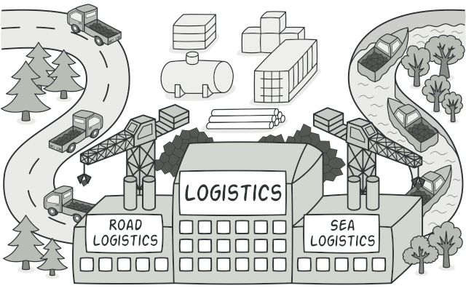
PROBLEM

Slide 4
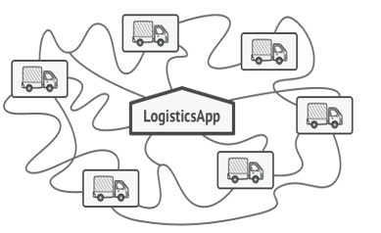
Logistics Transportation
The first version of app only handle transportation by trucks
→ major codes are inside the Truck class

Slide 5
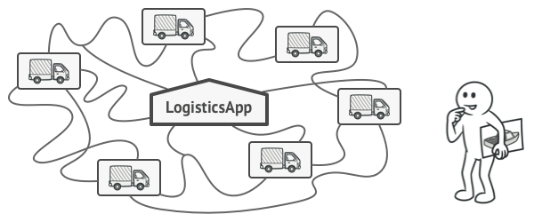
Question is?
IF WE WANT TO EXPAND OUR LOGISTICS MANAGEMENT TRANSPORTATION, WHAT WILL HAPPEN?

